Slide 1
Mobile programming
Lecture 3

Slide 2
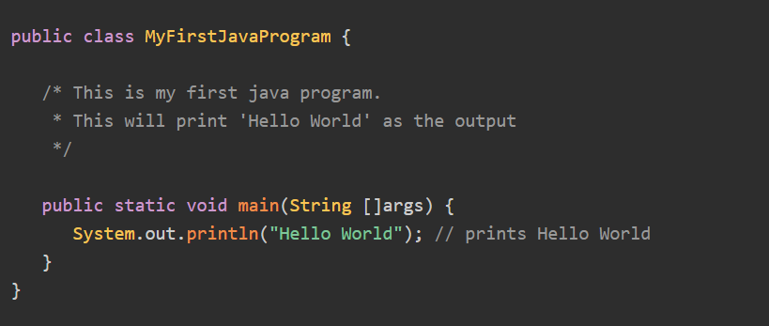
Recall!
We made our first Hello World Program in java
Learn two types of comment
/* * */
//

Slide 3
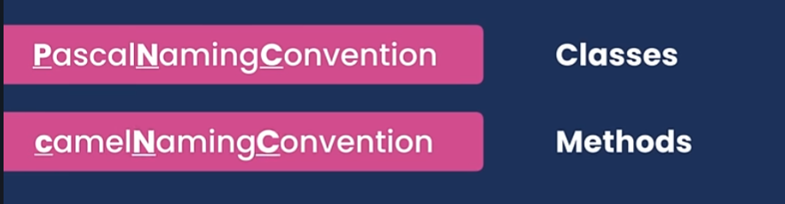
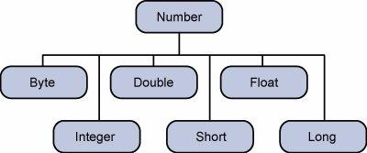
Recall!
sout (System.out.println()) method
Main mistakes
Java - Numbers Class

Slide 4
Recall!
Java Type Casting (Conversion)

Slide 5
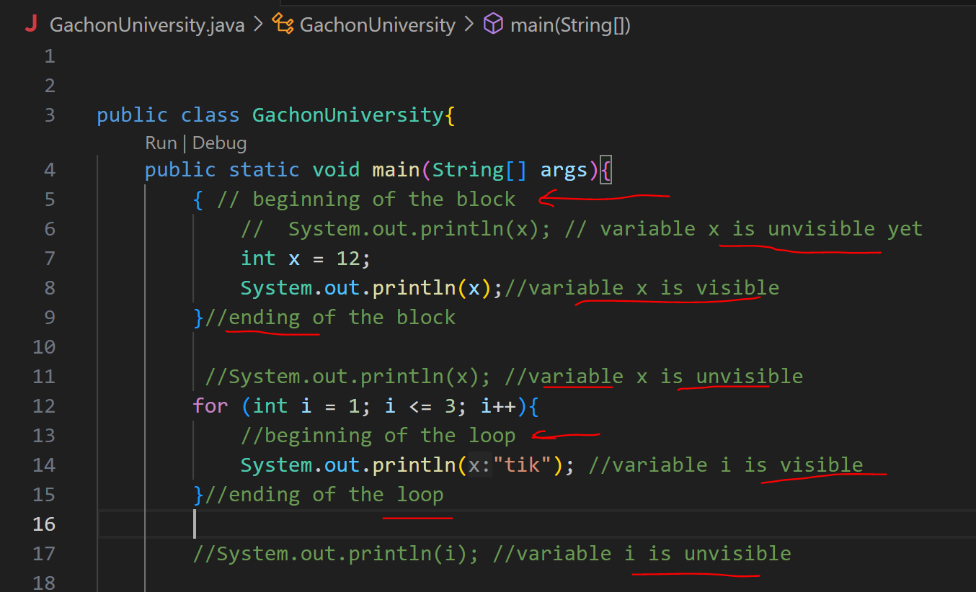
The area of the variable.

Slide 6
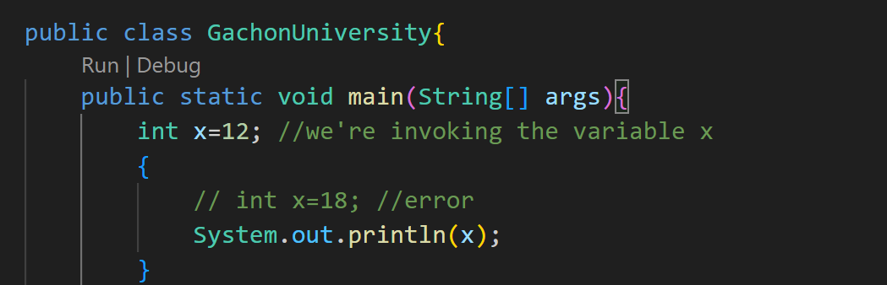
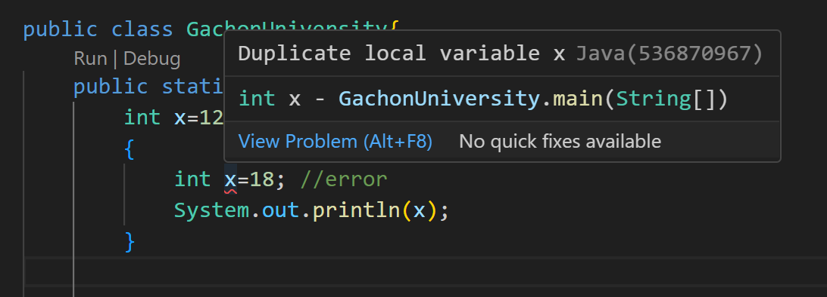
In Java, you cannot declare a variable in a nested block that has the same name as a variable in an outer block.

Slide 7
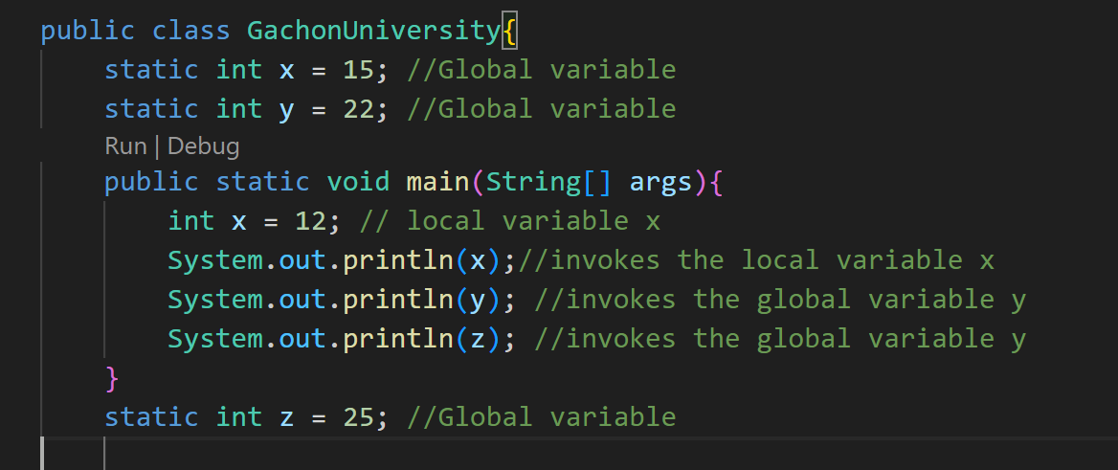
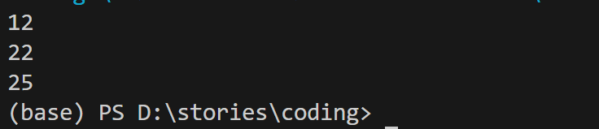
The global variable (class field) must be declared outside any method. It is available (visible) inside any method of this class. The global variable declaration can be placed in the code even after it is used in the method. If a local variable with the same name as the global variable is declared in the method or block, then the local variable has priority ("obscures itself" the global variable).
output:

Slide 8
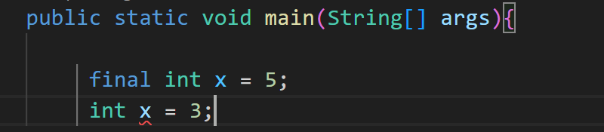
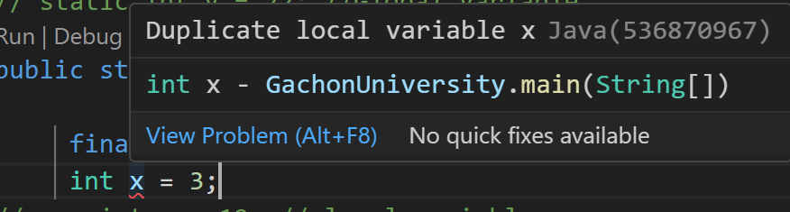
Variable rules:
// the name of the variable does not start from the number
// to write the same we can use english letters,numbers, _ and $ without space
// you cant use the key words such as; true, false, if, else if etc...
constant value

Slide 9
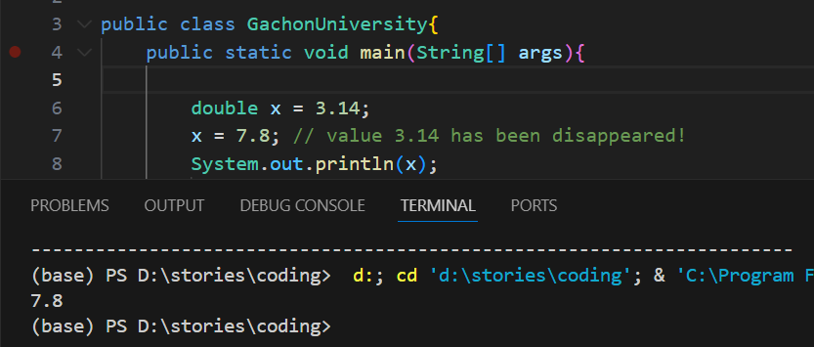
Assignment operation

Slide 10
Java - Basic Operators
There are different types of operators in Java, we have listed them below:
Arithmetic Operators #some of them we saw in lecture 3
Relational Operators
Bitwise Operators
Logical Operators
Assignment Operators
Misc Operators

Slide 11
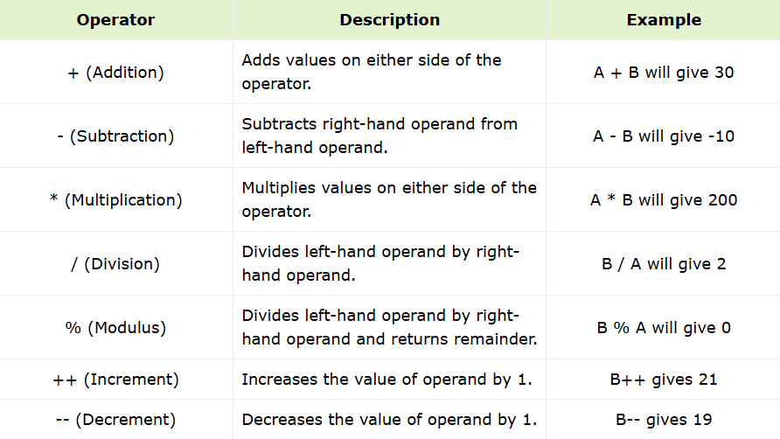
Java Arithmetic Operators
Arithmetic operators are used in mathematical expressions in the same way that they are used in algebra. Assume integer variable A holds 10 and variable B holds 20, then;

Slide 12
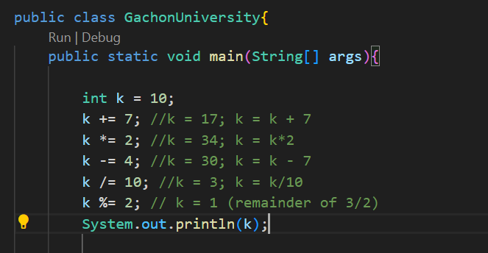
Lets see how can we use compound assignments operations: +=, -=, *=, /=, %=

Slide 13
Exercise:
Looking at the example you have to write same code for k = 20 and execute each line of code to check the results:

Slide 14

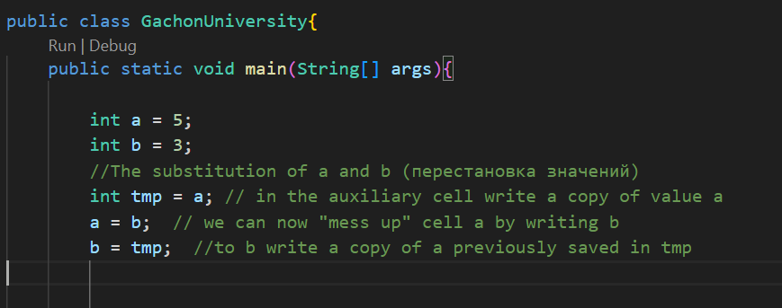
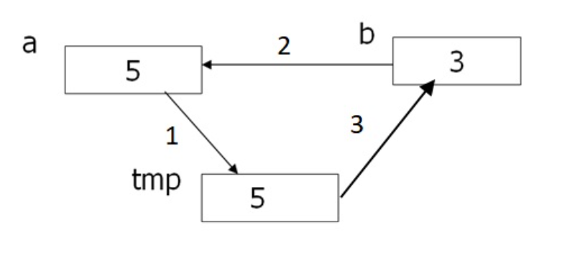
Let there be two variables a and b, and you need to change their values. How do you do this using the assignment operation?
Let’s imagine that we have not two variables, but two glasses. In a glass 1 is water, and in a glass 2 - coffee. And I want it to be the opposite: in glass 1 - coffee, and in glass 2 - water. What do you need to pour drinks? Right, you need a third glass! We temporarily pour in it, for example, coffee. Then glass 2 will be free, and you can pour water from glass 1 into it. In the empty glass, pour 1 cup of coffee from the auxiliary glass, which will then become unnecessary.
Also with variables. To change their values we need a third, auxiliary variable. Call it, for example, tmp (from English temporary). The sequence of actions will be as follows:
It is the rule of three glasses!

Slide 15
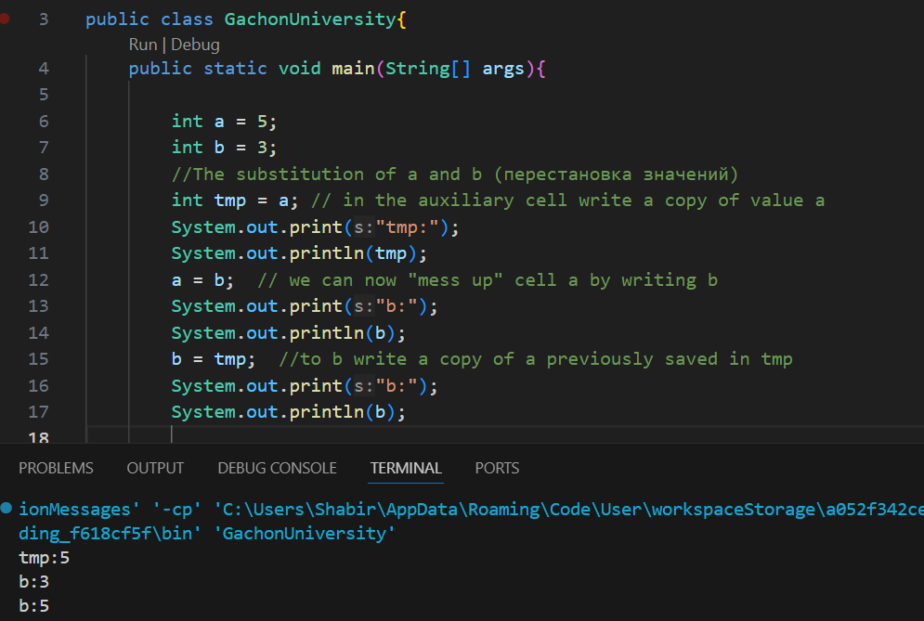

Slide 16
from right to left
x=y=z=100
first z = 100, then y=z, and then x = y
Which operator allows to increase the value of variable k by 3?
1. k = k + 3;
2. k = b + 3;
3. k+3 = k;
4. k = 3;

Slide 17
Exercise: You are given variables x and y , your task is to change places of these valuas:
x = 6
y = 9
output : y = 9, x = 6

Slide 18
Arithmetic operations in Java
Java defines arithmetic operations (+, -, *, /, %) that can be applied to numeric data of basic types, as well as values of char type.
-x One-dimensional minus: change the number sign to opposite : hint: int value = -x
+x Unary plus: does nothing
x + y addition
x - y subtraction
x * y multiplication
x / y division
x % y the remainder
your task make code for each arithmetic operation, x = 9 , y = 3

Slide 19
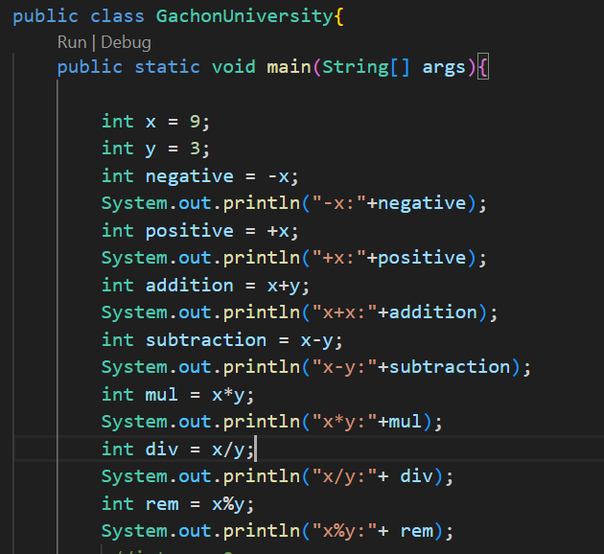
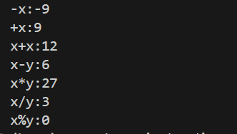
Output:

Slide 20
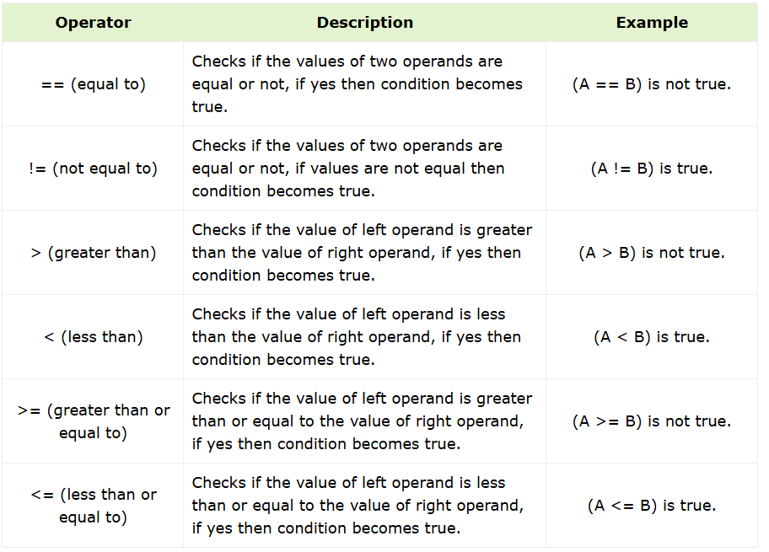
Java Relational Operators
Assume variable A holds 10 and variable B holds 20, then

Slide 21
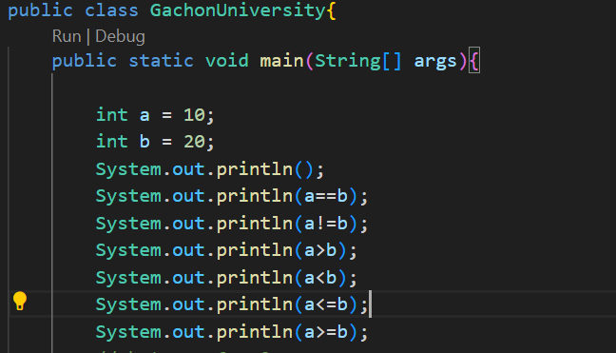
Output of Relational Operators

Slide 22
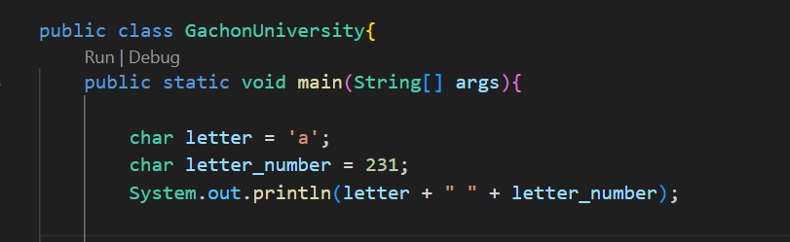
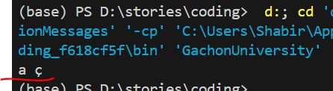
Character types
Java uses the char data type to store symbols. Note, however, that in Java characters are represented in Unicode. Unicode unifies dozens of character sets of multiple languages alphabets and other different characters. Initially, 16-bit space was needed to store characters, so a 16-bit char type was introduced in Java. The range of valid values for this data type is from 0 to 65536. Thus, a variable of type char we can assign both the number that will be converted into this number symbol and the character in single quotes.
Why?

Slide 23
Unicode
Unicode is an international character set that encompasses a vast range of characters, symbols, and scripts from many languages across the globe.
Before Unicode, there were multiple standards to represent character encoding −
ASCII − for the United States.
ISO 8859-1 − for Western European Language.
KOI-8 − for Russian.
GB18030 and BIG-5 − for Chinese.
So to support multinational application codes, some character was using single byte, some two. An even same code may represent a different character in one language and may represent other characters in another language.
To overcome above shortcoming, the Unicode system was developed where each character is represented by 2 bytes. As Java was developed for multilingual languages it adopted the Unicode system. The lowest value is represented by \u0000 and the highest value is represented by \uFFFF.

Slide 24
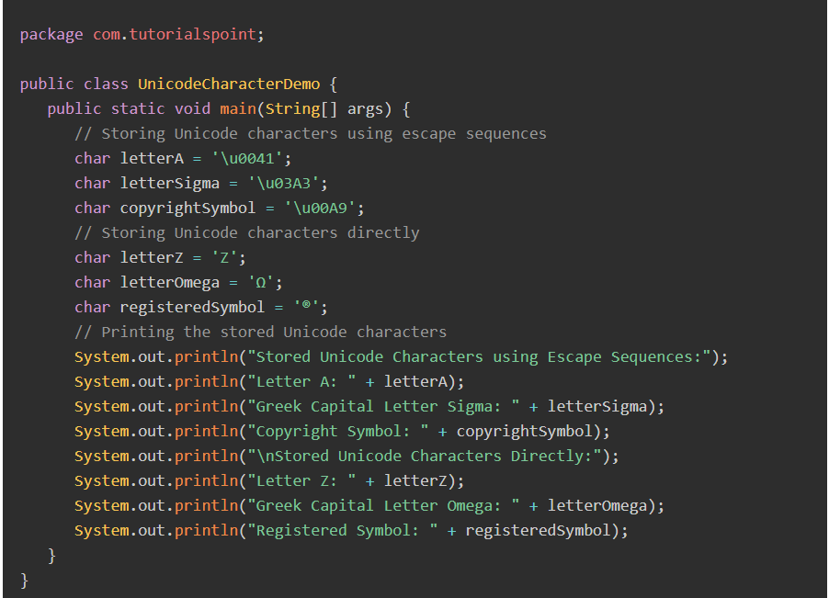
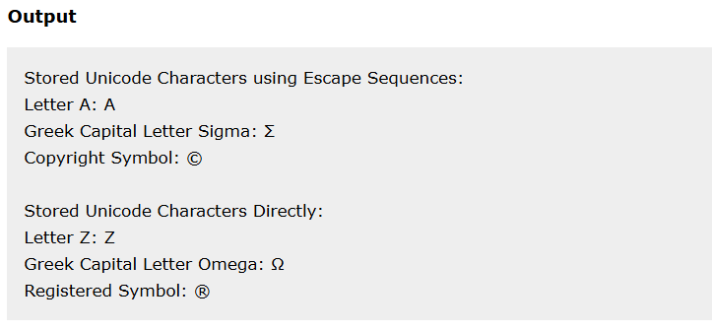
coming from the last example over the number 231 hiden character

Slide 25
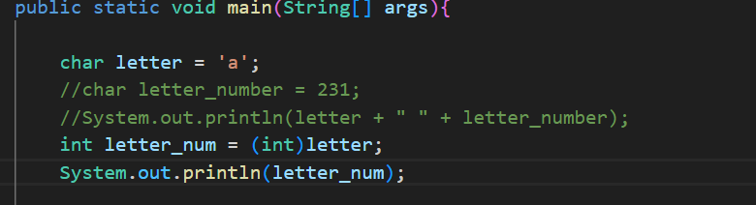

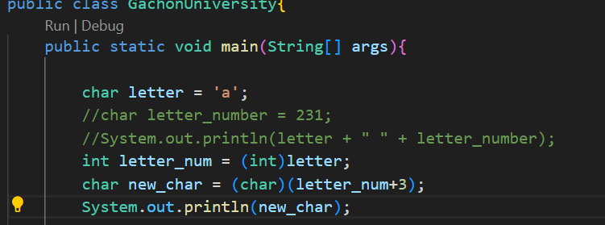


Slide 26
Exercise: Your task is to find the characters of these numbers and the numbers of these characters:
numbers = 14, 45, 77, 98
chars = ‘w’, ‘c’, ‘u’, ‘t’

Slide 27
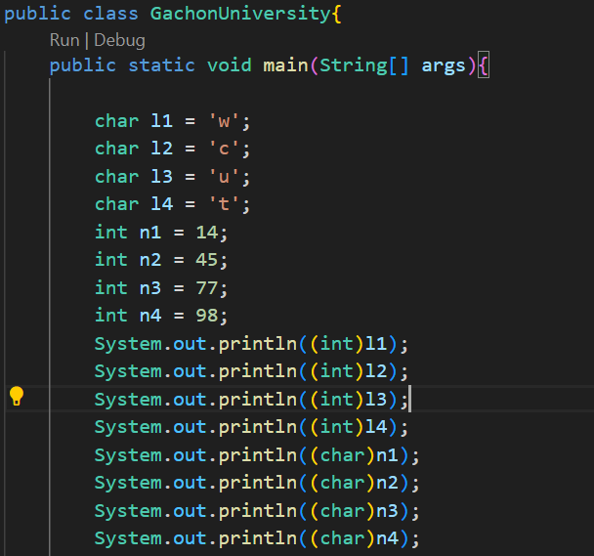
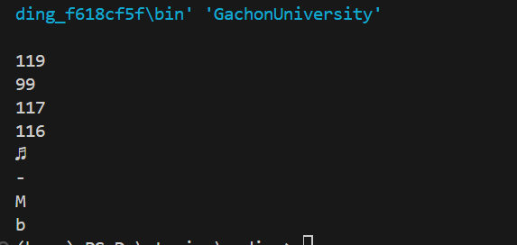

Slide 28
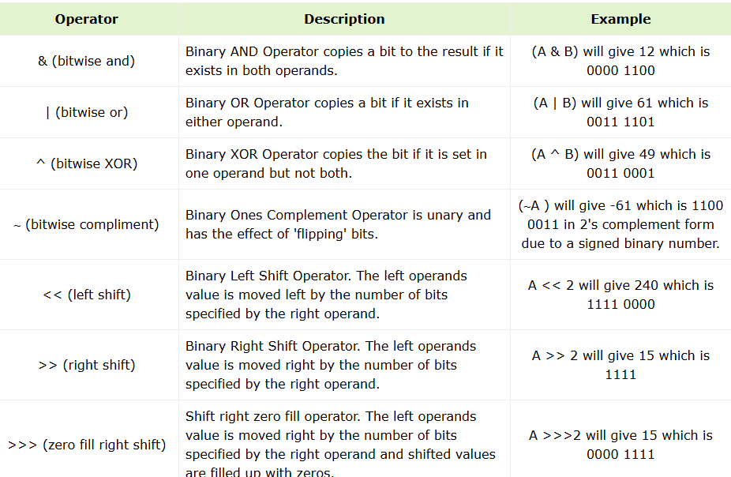
Java Bitwise Operators
Java defines several bitwise operators, which can be applied to the integer types, long, int, short, char, and byte. Bitwise operator works on bits and performs bit-by-bit operation. Assume if a = 60 and b = 13;

Slide 29
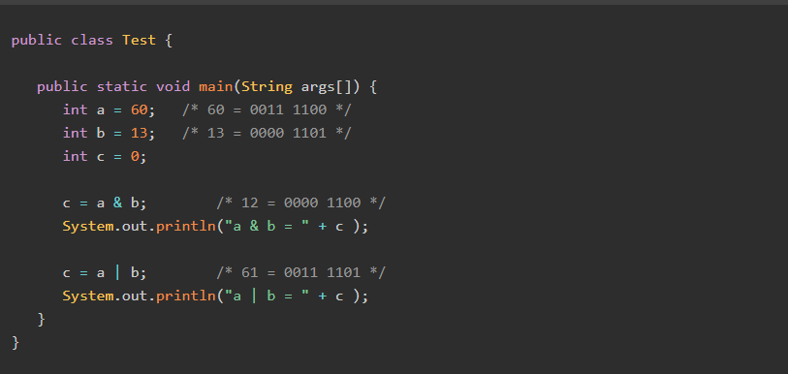
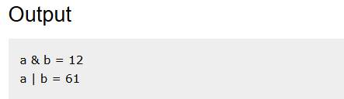

Slide 30
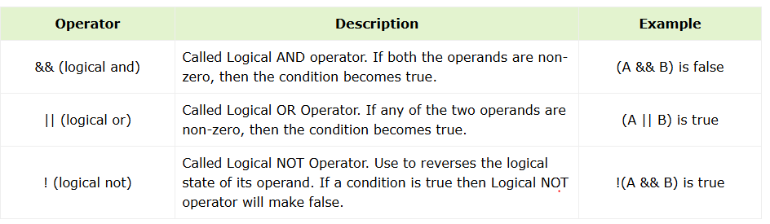
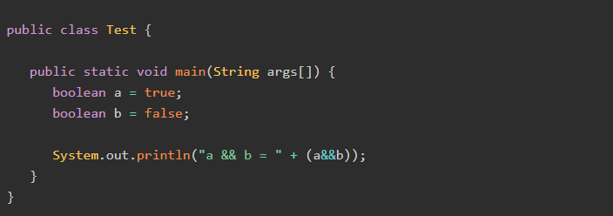
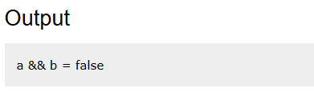
Java Logical Operators

Slide 31
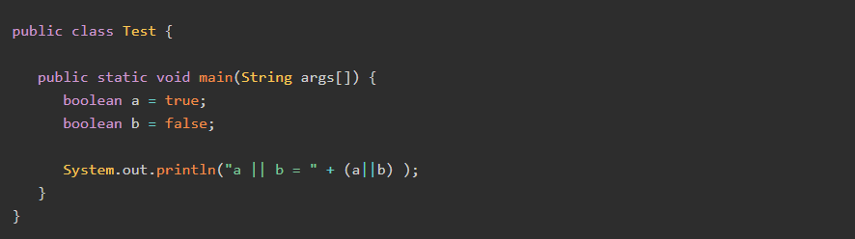
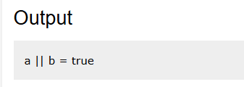
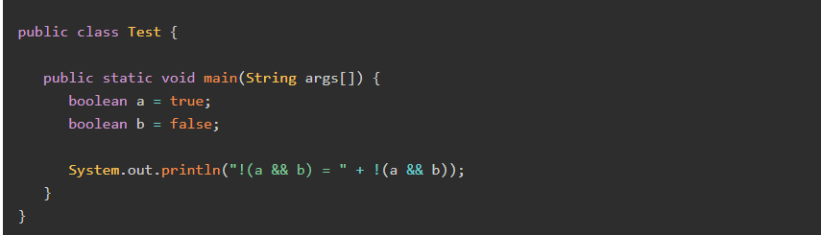
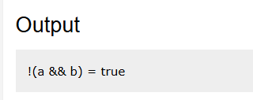

Slide 32
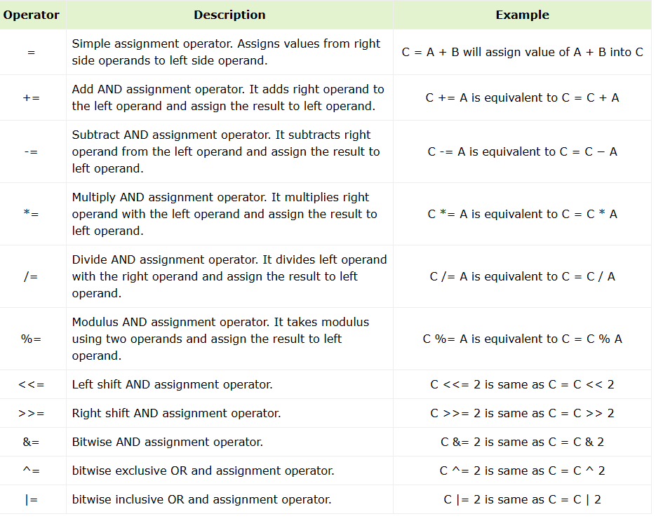
The Assignment Operators
Following are the assignment operators supported by Java language.

Slide 33
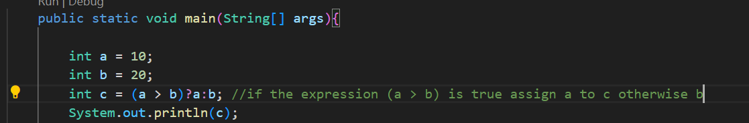

Java Miscellaneous Operators
There are few other operators supported by Java Language.
Conditional Operator ( ? : )
Conditional operator is also known as the ternary operator. This operator consists of three operands and is used to evaluate Boolean expressions. The goal of the operator is to decide, which value should be assigned to the variable. The operator is written as −
variable x = (expression) ? value if true : value if false
Example

Slide 34
Exercise: Your task to make new c value and assign the answer from expression
if a < b ? b:a
Value of a is : 30
Value of b is : 20
Exercise: Your task to make new c value and assign the answer from expression
if a > b ? a:b
Exercise: Your task to make new c value and assign the answer from expression
if a == b ? b:b

Slide 35
instanceof Operator
we will discuss it in our next class with string
Thanks for your attention

